Slide 1
PROFESSIONAL ETHICS CE 3142 CASE STUDIES - A
Faculty of Engineering,
The General Sir John Kotelawala Defence University
15th February 2023

Slide 2
TOPICS
Introduction
Building Collapses in Sri Lanka
Volkswagen Environmental Violation
The “Killer” Robot
Titanic
McDonald-Douglas DC 10
Space Shuttle Challenger

Slide 3
From HAMMURABI’S CODE OF LAWS Babylon 1754 BC (adapted from the L.W. King translation)
229 If a builder builds a house for someone, and does not construct it properly, and the house which he built falls and kills its owner, then that builder shall be put to death.
230. If it kills the son of the owner, the son of that builder shall be put to death.
232. If it ruins goods, he shall make compensation for all that has been ruined, and inasmuch as he did not construct properly this house which he built and it fell, he shall re-erect the house from his own means, that is at his own expense.

Slide 4
Minister allows 14-storey Blue Ocean project despite legal disputes
The plot on which Blue Ocean was putting up the highrise is a ‘Special Primary Residential Zone’ under the 2008 City of Colombo Development Plan (Amendment). The number of storeys allowed within such an area is five or ground plus four floors
It was feared that with the construction of an “unauthorised high rise structure on the subject premises, the adjoining properties and buildings will suffer serious and irreparable damage including cracks to walls and foundations, quite apart from violation of applicable regulations and environmental concerns”.
But in a gazette dated January 18, 2018, the Ministry , has designated the front lots along the eastern side of Layards Road to be a ‘Mixed Development Zone’.

Slide 5
Minister allows 14-storey Blue Ocean project despite legal disputes
This allows for the construction of offices, apartments, entertainment facilities and shops. The Minister’s signature on the gazette is dated July 14, 2017, not long after the residents took the matter to court.
The gazette gives effect to a revision of the City of Colombo Development Plan.
The amendment now allows Blue Ocean to proceed with its project.
The UDA rejected any suggestion that the amendment was introduced to favour a particular developer.
Sunday Times March 04, 2018
?????????

Slide 6
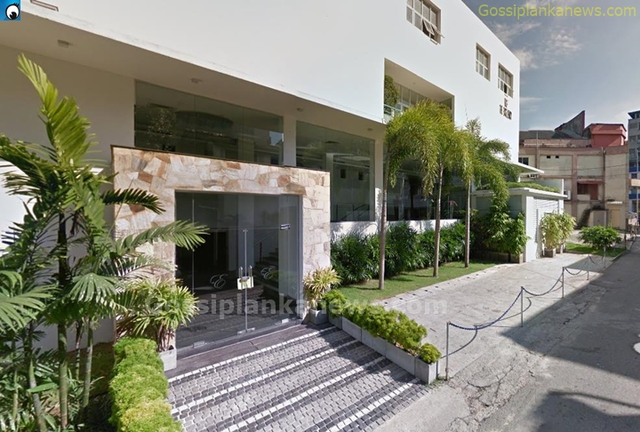
EXCELLENCY BUILDING COLLAPSE

Slide 7
The Excellency building collapse
On the 18th May 2017, a building named the “Excellency” situated on Charlemont Road, behind the Savoy Cinema, collapsed. The Wellawatte Police reported that 2 persons were killed and over 25 hospitalised at the Colombo National Hospital and Colombo South Teaching Hospital.
In 2009 approval was obtained to build a four storey [2B+G+1] building, with two basement car parks and ground & first floor Reception Halls.
From analysis of pre-collapse photographs and visual examination of the collapsed building, it would appear that three additional floors had been added at the front of the building and two additional floor at the rear of the building.

Slide 8
Wellawatte building collapse
The Structural designer, who had been introduced to the Owner by the Architect, was NOT a Chartered Engineer.
POSSIBLE REASONS FOR FAILURE:
Due to increased dead-weight of additional floors
Due to inadequate capacity of foundation
Due to dead-load due to construction materials stored on upper floors
Due to lack of competence of the Structural Designer*
*The Structural designer, who had been introduced to the Owner by the Architect, was NOT a Chartered Engineer.

Slide 9
Wellawatte building collapse
ISSUES:
Client illegally adding floors, without due consideration of the level of risk and the safety of life and property
Engineer acting beyond his level of competence and experience
Contractor undertaking work that apparently had not been authorized and approved by the Local Authority
Lack of monitoring of project by Local Authority

Slide 10
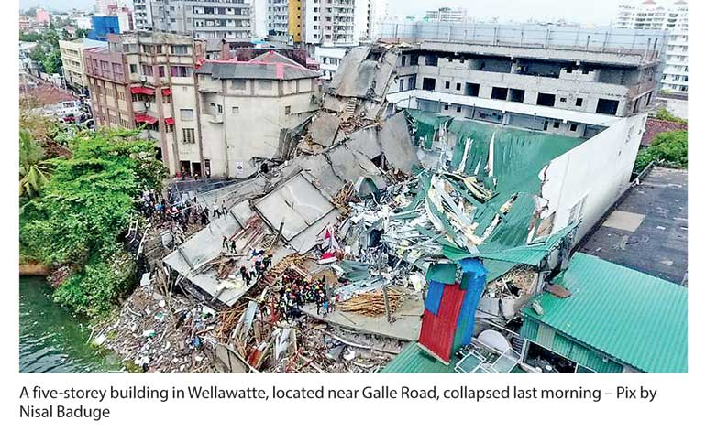
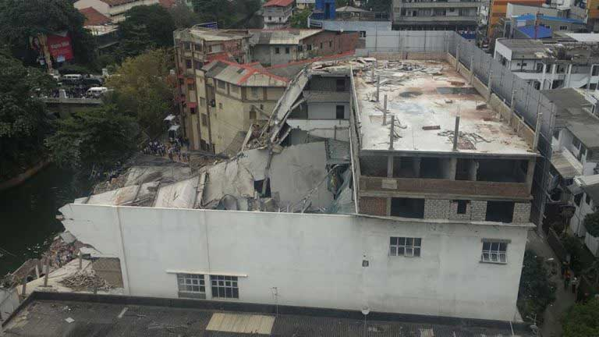
Wellawatte building collapse

Slide 11
KANDY HOUSE COLLAPSE
Three persons including a two month old infant died when a multi-storied building in Buwelikada, Kandy caved-in and collapsed on a hotel located down below.
The multi-storied building had been constructed at an extremely steep slope and when it collapsed, its debris had fallen upon two buildings that were located below this said building.
Approval had been given only to construct four stories but a fifth floor had been added illegally.
The NBRO pointed out that there were several water passages in the area where the house was built, and this house was built obstructing a waste water passage: this could have weakened the foundation of the house.

Slide 12
KANDY HOUSE COLLAPSE
The Kandy District geologist for the NBRO that the house was not built on stable land, and that “the constructors have not used the concrete and steel bars properly” ??. He also said that the construction of the house was not suited for the land it was built on, adding that “they should have researched these factors before the construction.”
The Construction Industry Development Authority (CIDA) found that failure in integrity, official due diligence and building standards were the main contributors to the disaster

Slide 13
KANDY HOUSE COLLAPSE
CIDA highlighted the following issues :
The original design was for two storeys, including a basement, and the foundation was designed accordingly
The addition of three more levels had been done without Kandy Municipal Council approval
The building was built on sandy soil having subterranean waterways
The design was inadequate to the extra loads imposed
The construction company was not registered with CIDA
Official monitoring of construction, including site inspections was lacking
The need for all clients, builders, consultants and contractors to adopt ethical practices

Slide 14
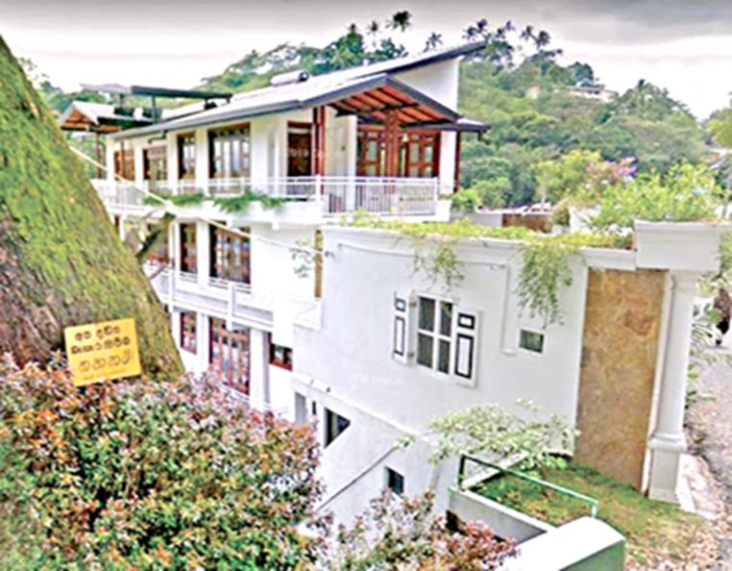
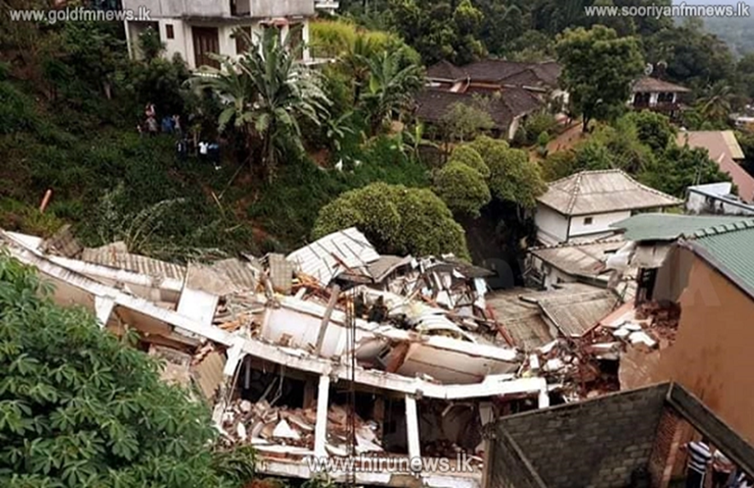
KANDY HOUSE COLLAPSE
Before
After

Slide 15
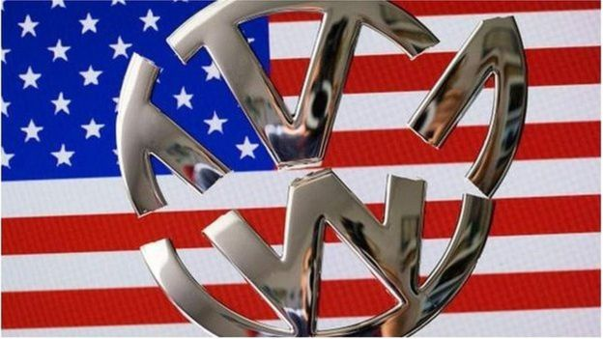
VOLKSWAGEN – ENVIRONMENTAL VIOLATION

Slide 16
Volkswagen – Environmental Violation
The US Environmental Protection Agency initiated a civil enforcement case against the Volkswagen Group, comprising VW, Audi and Porsche on allegations that Volkswagen violated the Clean Air Act by the sale of approximately 590,000 model year 2009 to 2016 diesel motor vehicles equipped with “defeat devices" in the form of computer software designed to cheat on federal emissions tests. The major excess pollutant at issue were oxides of nitrogen (NO_{x}), which are a serious health concern.

Slide 17
Volkswagen – Environmental Violation
Volkswagen, Audi, and Porsche installed software on certain diesel vehicles that is designed to detect when the vehicle is undergoing emissions testing and turns full emissions controls on only during the test. The effectiveness of emissions control devices is reduced during all normal driving. This results in cars that meet emissions standards in the laboratory or testing station, but during normal operation, emit nitrogen oxides at levels up to 40 times the standard. This software is a "defeat device" that is prohibited under the Clean Air Act.
.Volkswagen has paid for the alleged civil violations of the Clean Air Act. settlements totaling more than $15.2 billion and government fines of $4.3 billion

Slide 18
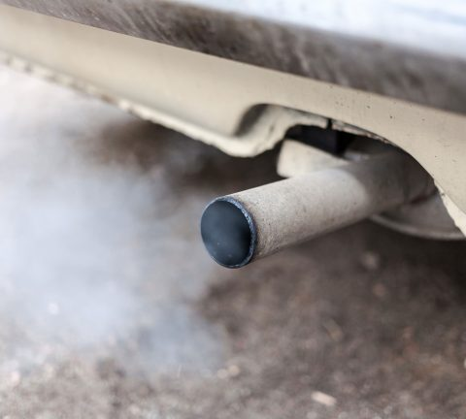
Volkswagen – Environmental Violation
Health Effects of NOx Pollution
NOx is a serious health concern, according to the EPA. Such pollution contributes to the creation of harmful smog and soot. Exposure to smog or soot is linked to multiple respiratory and cardiovascular-related health problems, as well as premature death.
NOx emissions form nitrogen dioxide, which can intensify respiratory diseases such as asthma. Nitrogen dioxide may also contribute to the development of asthma in children.
Those at particular risk of health reactions
connected to smog or soot exposure include:
Children
Older adults
Anyone who is active or works outdoors
Anyone with heart or lung disease

Slide 19
Volkswagen – Environmental Violation
ISSUES :
Failure to hold supreme the health, safety and welfare of the public
Failure to minimize the adverse environmental impact of their works, so as to protect both present and future generations
Failure to comply with legislative, regulatory and policy aspects of environmental protection
Failure by Engineer(s) party to this deception to “whistle blow” and alert the Authorities of this irregular activity which was not safe for human health and welfare
Conflict of Interest – where greed and the need to maximize profits overshadowed the public welfare
Deliberate mis-use of technology, contrary to all ethical principles, and endangering life

Slide 20
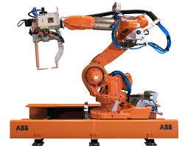
THE CASE OF THE “KILLER” ROBOT

Slide 21
The case of the “Killer” Robot
On May 17, 1992 a Silicon Techtronics Robbie CX30 industrial robot killed its operator, Bart Matthews, at Cybernetics, Inc., in Silicon Valley.
An investigation into the cause of the accident led authorities to the conclusion that a software module, written and developed by Randy Samuels, a Silicon Techtronics programmer, was responsible for the erratic and violent robot behavior which in turn lead to the death by decapitation of Bart Matthews.
Randy Samuels was charged with man-slaughter by the County of Silicon Valley

Slide 22
The case of the “Killer” Robot
Investigations into the incident revealed that:
The company Techtronics, the designers of Robbie [CX30] robot were financially unstable,
Needed to successfully complete the CX30, to redeem their reputation,
Pressurized the staff to rush through project, to the extent of taking “short cuts” and ignoring established procures for checking and verifying
Randy Samuels’ expertise lay in specifications and computations; he was not a Programmer
He used software without proper authorization
An associate developed fraudulent software test to ensure compliance with quality assurance procedures of the software programme written by Randy Samuels

Slide 23
The case of the “Killer” Robot
The Association for Computing Machinery [ACM]. States that ACM members have the:
general moral imperative to contribute to society and human well-being,
to avoid harm to others,
to be honest and trustworthy,
to give proper credit for intellectual property,
to access computing and communication resources only when authorized to do so,
to respect the privacy of others and to honor confidentiality.
Beyond that, there are professional responsibilities, such as the obligation to honor contracts, agreements, and assigned responsibilities, and to give comprehensive and thorough evaluations of computing systems and their impacts, with special emphasis on possible risks.
Several of the people involved in the killer robot case are ACM members and there is cause to believe that they have acted in violation of our Association's code of ethics.
The ACM investigated ACM members who might be in gross violation of the code as “…..the killer robot incident has not only cost a human life, but it has done much to damage the reputation of the computing profession.”

Slide 24
The case of the “Killer” Robot
Ethical Issues:
At Corporate level, violation of Professional Ethics by:
Disregarding Standards and Procedures
Endangering life and property by failing to do a comprehensive and thorough evaluations of computing systems and their impacts, with special emphasis on possible risks.
Disregarding safety to meet corporate targets
Bringing disrepute to the Profession [i.eACM] through negligence
At Personal level, violation of Professional Ethics by:
Doing work in areas outside one’s competence
Falsifying information and procedures to hide and misrepresent the actual situation

Slide 25
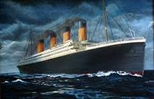
RMS TITANIC

Slide 26
RMS TITANIC
The RMS Titanic was the largest and most luxurious ship built at that time, and because of its superior design and engineering features was considered to be “unsinkable”.
It began its maiden voyage to New York On April 10, 1912, from Southampton, England.
Two days later it struck an iceberg that was three to six times larger than its own mass, damaging the hull, so that the six forward compartments were ruptured.
The flooding of these compartments was sufficient to cause the ship to sink within two hours and 40 minutes with a loss of more than 1,500 lives.

Slide 27
RMS TITANIC
The MD of the White Star Line was aboard the Titanic. Competition for Atlantic passengers was fierce and the White Star Line wanted to show that they could make a six-day crossing, which would be the fastest at that time. To do this the ship could not slow down and had it is believed that the MD pressurized the Captain to maintain the maximum of speed of about 21.5 knots.
The Captain of the Titanic was a very senior officer of the White Star Lines, and this was his final voyage before retirement, and all he had to do was get to New York in record time.
In the two days after leaving England, the Captain and received seven iceberg warnings from his crew and other ships, which he ignored.
If he had called for the ship to slow down and strengthened the look-out, then maybe the Titanic disaster would not have happened.

Slide 28
RMS TITANIC – Design Lapse
The belief that the ship was unsinkable was due to the fact that the Titanic had sixteen watertight compartments (bulkheads ), with electrically operated watertight doors, that extended from the ship's double bottom through four or five of her nine decks and were said to make the ship "unsinkable”
They divide the ship into watertight compartments which prevents seeping of water to other parts of the ship in case the hull is broken. They provide maximum safety in times of flooding or damage of hull.
However, the compartments did not reach as high as they should have done, because the owners did not want them to go all the way up because this would have reduced living space in first class cabins.
If the marine architect, who designed the ship, had insisted on making them the correct height then maybe the integrity of the watertight compartments would have been ensured.

Slide 29
RMS TITANIC – Safety lapses
The total capacity of the Titanic was 3,547 including crew.
The legal requirement of lifeboats was measured on the weight of the ship not on the number of passengers.
The Titanic was designed for 32 lifeboats, but only carried 20 lifeboats, enough for 1,178 people although there were 2,208 on board.
The 32 lifeboats were reduced to 20 because it was felt that the deck would be too cluttered and spoil the aesthetics of the Titanic.
In loading the lifeboats the crew did not follow the British maritime tradition (Birkenhead) of “women and children first”. They discriminated by loading by class, resulting in 76% of the 3rd Class cabin passengers dying, and not loading the lifeboats to their full capacity of 65, most being only partially full.
Finally there were only 706 survivors.

Slide 30
RMS TITANIC – Ethical Issues
The White Star Line Company’s [WSLC] failure to safe-guard LIFE and PROPERTY
Reduction of lifeboats from designed amount of 32 to 20
Modifying the design of the 16 watertight compartments so partitions were not at full height
Failure to advice captain and crew that the steel used for the hull becomes brittle at extremely cold temperatures and ruptures easily on impact:
Instructing the captain to somehow complete the crossing in six days, encouraging him to run at the maximum speed at all time, especially at night when visibility was poor. The need to be extra vigilant at night.

Slide 31
RMS TITANIC – Ethical Issues
The failure of the Marine Architect/Designer, a well recognized engineer to “WHISTLE BLOW” :
To make public WSLC’s non-compliance with Board of Trade’s prescribed number of lifeboats.
Non-disclosure of WSLC’s change of the watertight compartments, which could pose a major risk
The failure of the Captain who was a very experienced ship’s captain to act with no regards for the SAFETY of the passengers in his charge :
To withstand the owner’s insistence that he maintains maximum sailing speed, irrespective of time of day, visibility, icebergs
A false sense of the infallibility of the Titanic i.e it was “unsinkable”

Slide 32
RMS TITANIC – Ethical Issues
The failure of the crew who were indifferent to the SAFETY of the passengers:
Not abiding be the established tradition of the British Maritime services that “women and children are first” in the rescue sequence.
By discriminating in the selection of passengers, giving preference to the affluent travelling in first class
By not filling many of the lifeboats, resulting in many being only half full: many more could have been saved if lifeboats were fully loaded.

Slide 33
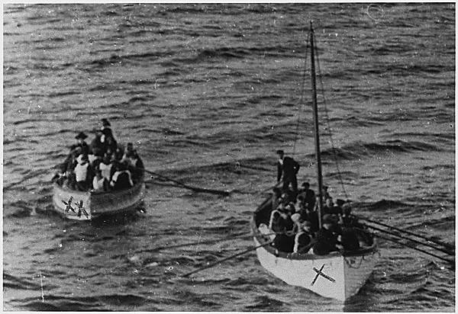
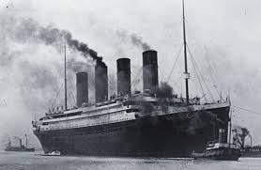
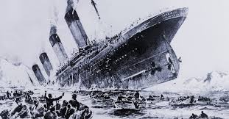
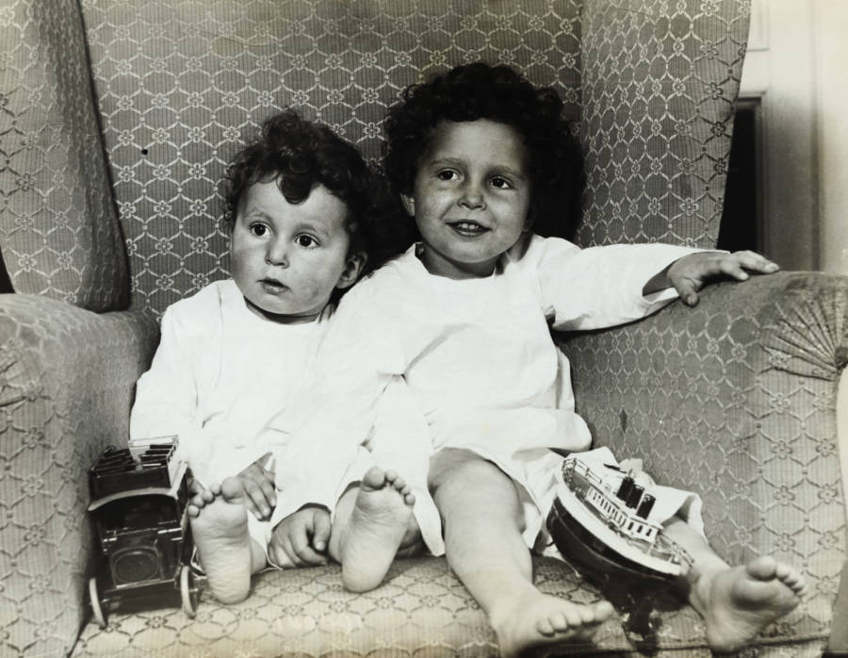
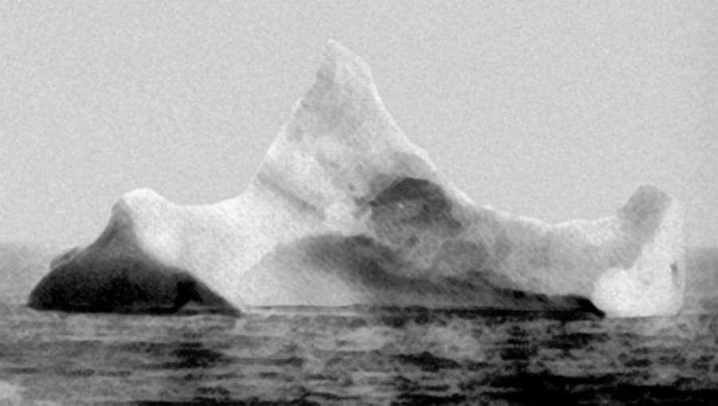
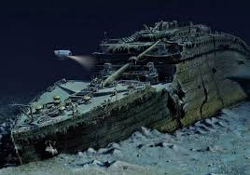
RMS TITANIC

Slide 34
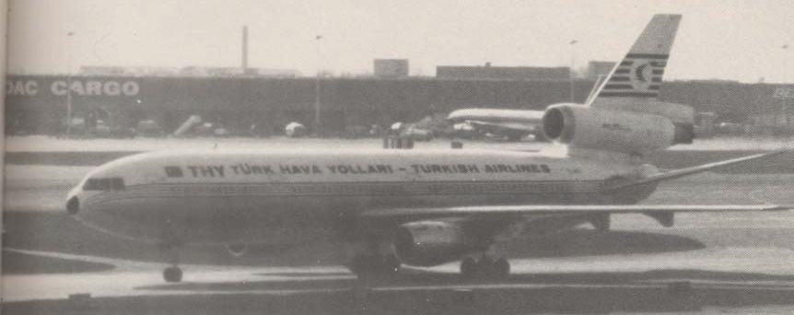
McDonnell Douglas DC-10 – Turkish Airlines flight 981

Slide 35
McDonnell Douglas DC-10 – Turkish Airlines flight 981
Since production began in 1969, the McDonnell Douglas Corporation has built 385 DC-10's and 60 of the KC-10, a military air tanker based on the DC-10: production ended in 1983
Fifty-one airlines operate the plane
In 1968, Douglas awarded Convair, a division of General Dynamics, the contract to build the fuselage, including the cargo doors
In May 1970, the first DC-10 was assembled and underwent ground tests in preparation for its maiden flight
During one of these ground tests, as the fuselage was being pressurized to test the air conditioning system, the rear cargo door flew open, resulting in a rapid depressurization of the cargo compartment. Instantly, the pressure in the cabin caused the passenger floor to buckle, collapsing into the cargo hold and severing all hydraulic flight control lines

Slide 36
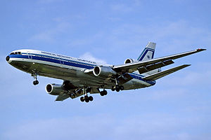
McDonnell Douglas DC-10 – Turkish Airlines flight 981
The McDonnell Douglas investigators came to the conclusion that the door was simply not properly locked in place and that it was extremely unlikely that the incident would be repeated
The failure was blamed on the mechanic who had improperly closed the door.
The end result was a series of small fixes that did not significantly improve the door-latching mechanism

Slide 37
McDonnell Douglas DC-10 – Turkish Airlines flight 981
This critical defect should have been noticed during FAA certification.
However, it is important to note that much of the work involved during certification testing is actually done by the manufacturers themselves in the name of the FAA. Because the FAA lacks the manpower and in some cases the expertise to inspect every aspect of an airliner, it appoints designated engineering representatives (DERs). In this instance, these men were paid by McDonnell Douglas, but spent a part of their working lives “wearing an FAA hat”.

Slide 38
McDonnell Douglas DC-10 – Turkish Airlines flight 981
On June 12, 1972 American Airlines Flight 96, a DC-10, departed from Detroit. Prior to take-off, the last compartment to be secured was the rear cargo compartment. However, the cargo handler found it difficult to lock the rear cargo door completely and to do so used force, which closed the handle and caused the vent door to move into its proper position. Unfortunately, the internal mechanism was damaged, and the door was never properly locked
At an altitude of 11,750 feet, this rear cargo compartment door separated from the plane in flight. The rapid decompression that followed caused the floor to partially collapse into the cargo compartment, breaking various hydraulic control cables that were routed through the floor beams to the rear control system
The pilot, because of his experience, was able to land the plane safely at Detroit. This is the referred to as the ”Windsor Incident”

Slide 39
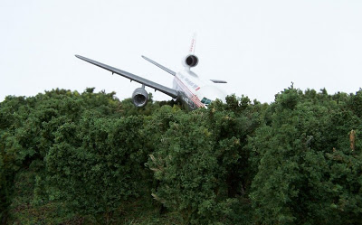
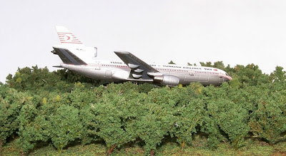
McDonnell Douglas DC-10 – Turkish Airlines flight 981
On March 3, 1974, Turkish Airlines Flight 981, a DC-10 out of Paris (see Fig. 1), experienced explosive decompression ten minutes after take-off when the rear cargo door burst open. The cargo area evacuated, and the floor of the passenger area, which separated the cabin from the lower cargo hold, buckled under the enormous pressure differential. As a result, the hydraulic control lines that ran under this floor to the tail of the craft were severed, and witnesses watched as the nonresponsive plane plummeted at nearly 500 mph into the Ermenonville forest outside Paris, killing all 346 people onboard

Slide 40
McDonnell Douglas DC-10 – Turkish Airlines flight 981
The crash of Flight 981 is worth further examination because it is an excellent case study of how safety and ethics can be compromised. McDonnell Douglas overlooked incidents that indicated a potentially fatal safety problem, and the penalty was the loss of hundreds of lives
The Engineers’ Opinions
In 1969 MD requested that Convair draft a Failure Mode and Effects Analysis (FMEA) for the cargo door locking system.
The resulting study identified nine possible sequences that could produce a life-threatening situation, including the exact sequences which occurred both in the Windsor Incident and on Flight 981.
However, this report was never shown to the FAA by Douglas, nor could Convair contact the agency by terms of their contract. Indeed, the FMEAs later submitted to the FAA by McDonnell Douglas for certification of the DC-10 made no mention of malfunctions of lower cargo doors

Slide 41
McDonnell Douglas DC-10 – Turkish Airlines flight 981
In most cases airplane malfunctions are not discovered until after a major incident occurs; however, here McD-D was presented with a problem in their design well before the first commercial flight.
The fact that the problem with the cargo door and the hydraulic lines was not taken seriously indicates that McD-D lost sight of the first responsibility of an engineer, which is to “hold paramount the safety, health and welfare of the public” and “take responsibility for the consequences of their work”

Slide 42
McDonnell Douglas DC-10 – Turkish Airlines flight 981
After the Windsor incident an Airworthiness Directive should have been issued, which could have grounded the plane until the cargo door issue was corrected
At the time, this result was critical to McD-D financially and so it was necessary in this competitive business to obtain orders from foreign airlines. That summer, McD-D was launching a large-scale sales campaign targeting Middle Eastern airliners
The issuing of an AD at this juncture would have publicly cast doubt onto the company’s sales focus, giving plenty of room to competitors, before full confidence in the plane could be reinstated
However, before the AD was issued, McD-D President worked out a Gentleman’s Agreement with the FAA, where McD promised to fix the problems with the cargo door and the FAA agreed to have a less stringent certification process

Slide 43
McDonnell Douglas DC-10 – Turkish Airlines flight 981
A significant event pertaining to the Turkish Airlines crash, however, involved a memorandum written immediately after the Windsor Incident by Daniel Applegate, who was chief product engineer for Convair and thus in charge of the cargo door’s design.
In this formal appeal to his management, he urged that McD-D be approached about the door, because of their decisions which gradually degraded the door’s safety systems, which could lead to the loss of the airplane.
However, his superiors believed that this action might damage Convair’s relationship with McD-D, and they did not pursue the matter any further. The matter ended there !!

Slide 44
McDonnell Douglas DC-10 – Turkish Airlines flight 981
A significant event pertaining to the Turkish Airlines crash, however, involved a memorandum written immediately after the Windsor Incident by Daniel Applegate, who was chief product engineer for Convair and thus in charge of the cargo door’s design.
In this formal appeal to his management, he urged that McD-D be approached about the door, because of their decisions which gradually degraded the door’s safety systems, which could lead to the loss of the airplane.
However, his superiors believed that this action might damage Convair’s relationship with McD-D, and they did not pursue the matter any further. The matter ended there !!

Slide 45
McDonnell Douglas DC-10 – Turkish Airlines flight 981
ETHICAL ISSUES :
McD-D’s failure to safe-guard LIFE and PROPERTY
McD-D staff acting as FAA inspector is a definite conflict of interest
The failure to highlight the problem with the cargo door of the DC-10 is a classic example of how mistakes can be ignored / overlooked when manufacturers are given the opportunity to police themselves
Non-disclosure of FMEA to FAA – hiding of the TRUTH
The dubious “Gentlemen’s Agreement” between the heads of McD-D and FAA, which would indicate that the head of the FAA would have received a handsome reward for soft-peddling the issue.
Applegate’s failure to “whistle blow”

Slide 46
BOEING 737 Max9 DoorPlug Blowout
The Jan. 5, 2024, explosive decompression after takeoff of an Alaska Airways flight was related to a component called a “door plug” being ejected from the fuselage of the aircraft.
Following the in-flight blowout of the Door Plug of a Boeing 737 Max 9, federal regulators have grounded planes and are stepping up scrutiny of Boeing’s manufacturing process.
The investigation is focused on four bolts that hold the door plug in place. The National Transportation Safety Board is trying to determine if they fell off during the event or if they were never installed to begin with.
Based on new information, it may be the latter.

Slide 47
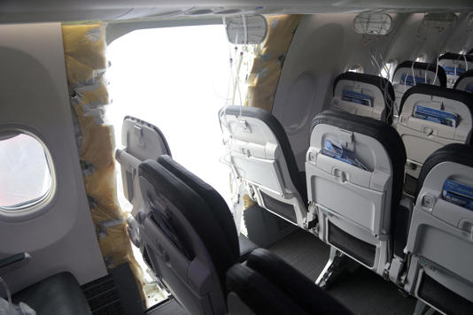
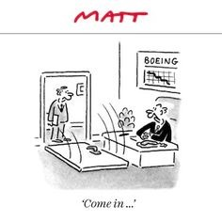
BOEING 737 Max9 DoorPlug Blowout
Boeing Co.’s use of multiple record-keeping systems to log work during final construction of its 737 Max jets may have played a role in the manufacturing lapse that led to this accident.

Slide 48
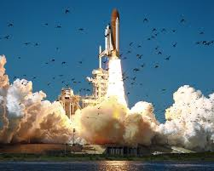
The Space Shuttle Challenger

Slide 49
The Space Shuttle Challenger
Just 73 seconds after its launch, on 28 January 1986, space shuttle Challenger broke apart, killing its seven crew members. The subsequent Rogers Commission found the cause of the accident was the failure of both primary and secondary O-rings on the right solid rocket booster, allowing hot gas and flame to escape, which then came into contact with the booster attachment and external tank, resulting in structural failure.
The problems with the O-rings had been known about for nine years but had been ignored, partly because safety was deemed ensured with the presence of the second ring. However, as was later made clear, the second ring was there for unforeseen failure, not a failure that had been considered. Engineers' warnings that low temperatures would aggravate the problem were also ignored by NASA managers because of pressure to keep to the launch timetable.

Slide 50
The Space Shuttle Challenger
Roger Boisjoly was a booster rocket engineer at NASA contractor Morton Thiokol in Utah in January, 1986, when he and four colleagues became embroiled in the fatal decision to launch the Space Shuttle Challenger
The problem, Boisjoly wrote, was the elastic seals at the joints of the multi-stage booster rockets. They tended to stiffen and unseal in cold weather and NASA's ambitious shuttle launch schedule included winter lift-offs with risky temperatures, even in Florida.
On January 27, 1986, the forecast for the next morning at the Kennedy Space Center included a launch-time temperature as low as 30 degrees Fahrenheit. NASA had never launched in temperatures that cold and Boisjoly and his four colleagues at Thiokol headquarters in Utah concluded it would be too dangerous too launch

Slide 51
The Space Shuttle Challenger
At first, Thiokol managers agreed with them and formally recommended a launch delay. But NASA officials on a conference call challenged that recommendation.
"I am appalled," said NASA's George Hardy, according to Boisjoly and our other source in the room. "I am appalled by your recommendation."
The NASA pressure caused Thiokol managers to "put their management hats on," as one source told us. They overruled the objections and told NASA to go ahead and launch.
The tragedy 28th January 1986 is now history !!
In summing up the disaster, Richard Feynman, a member of the Rogers Commission, made a telling point to the effect that "for a successful technology, reality must take precedence over public relations, for nature cannot be fooled

Slide 52
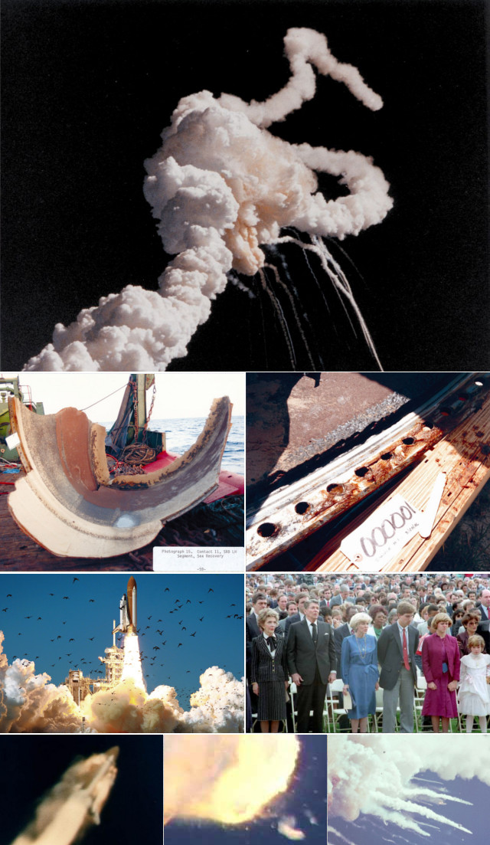
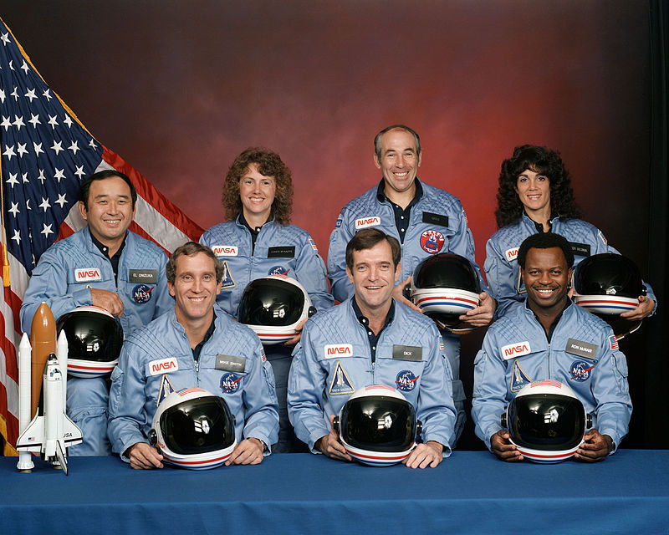
The Space Shuttle Challenger

Slide 53
The Space Shuttle Challenger
ISSUES:
This disaster has been used to teach many lessons:
primarily that that the advice of engineers should be considered carefully by management;
that more importance was placed on the commercial / political aspects than on the technical
that the ethics of whistle-blowing and group decision-making should be introduced and encouraged

Slide 54
ETHICAL ISSUES
Corporate goals over-riding Engineering and Technical concerns | Challenger Space Shuttle
 | McDonnell Douglas DC-10 Aircraft
 | Titanic
 | Techtronics CX30 Industrial Robot
Failure to safeguard life and property | Challenger Space Shuttle
 | McDonnell Douglas DC-10 Aircraft
 | Titanic
 | Techtronics CX30 Industrial Robot
 | Excellency & Kandy Buildings
 | Volkswagen Diesel vehicles in the USA
Not making public serious engineering flaws - failure to “whistle blow” | Challenger Space Shuttle
 | McDonnell Douglas DC-10 Aircraft
 | Titanic
Conflict of Interest | McDonnell Douglas DC-10 Aircraft
Working outside Competence | Techtronics CX30 Industrial Robot
 | Excellency Building

Slide 55
ACKNOWLEDGEMENT
https://www.epa.gov/enforcement/volkswagen-clean-air-act-civil-settlement
Volkswagen: The scandal explained - Russell Hotten, Business reporter, BBC News, 10 December 2015: http://www.bbc.com/news/business-34324772
https://ethics.csc.ncsu.edu/risks/safety/killer_robot/killer_intro.html
https://www.researchgate.net/publication/242362942_The_case_of_the_killer_robot
https:// turkishdc10files:wordpress.com/an analysis of mcdonnell douglas’ ethical responsibility in the crash of turkish airlines flight 981
Business Insider ; The Alaska Airlines door plug — - Story by trains@insider.com (Taylor Rains)
Bloomberg : Boeing's Dual Record Logs Eyed in 737 Max 9 Door Blowout - Story Alan Levin and Ryan Beene •
https://www.engineering.com/Library/.../85/.../Five-Biggest-Engineering-Disasters.asp..
https://en.wikipedia.org/wiki/Space_Shuttle_Challenger_disaster
https://en.wikipedia.org/wiki/Rogers_Commission_Report
https://www.npr.org/sections/thetwoway/2012/02/06/146490064/remembering-roger-boisjoly-he-tried-to-stop-shuttle
https://www.pinterest.com/pin/647181408924574000/
https://en.wikipedia.org/wiki/rms RMS Titanic_disaster
Titanic images : fortune.com, irish central.com, John Kunoshi
https://www.gossiplankanews.com
http://www.dailynews.com
https://www.sundayobserver.lk/2020/09/27/news-features/nbro-report-

Slide 56


Slide 57


Thank You !!!

